Slide 1
Unleashing Healing Power Through Spirit-Born Emotions
By Mark Virkler & Charity Kayembe
PowerPoint for Chapters 1 - 8

Slide 3
Chapter One
The church has had a rocky relationship with emotions over the years…
They are soulish, so discard

Slide 4
The Kingdom of God is EMOTIONS
Peace and joy in the Holy Spirit (Rom. 14:17). Wow!

Slide 5
These emotions are spirit realities, arising from the Holy Spirit. So not mental constructs, not fake, but true emotions in our hearts.

Slide 6
Hmm… Jesus embraced emotions
Jesus, moved by compassion healed (Matt. 14:14).
How important is compassion?

Slide 7
Do I have a theology concerning the role of emotions to bring forth a miracle of healing? NO!

Slide 8
Emotions are more than soulish. They exist in our spirits!
Ezekiel said, “I went embittered in the rage of my spirit, and the hand of the LORD was strong on me”
(Ezek. 3:14 NASB).”

Slide 9
Observations concerning emotions:
I can have emotions in my spirit
May be placed there by God
Empower me for ministry!

Slide 10
God spoke: “I want to restore emotions to your life and I want you to do three things to restore the emotions. I want you to read through the Gospels and see that I, Jesus, moved by compassion, healed, and that it is OK to have emotions and to let them lead in your life and ministry.”

Slide 11
“Next, I want you to read the Psalms and notice that David had emotions and expressed them ALL to Me, and that was perfectly fine. I can handle all your emotions as you present them to Me. Finally, I want you to notice how tenderly I love you in your two-way journaling, and then I want you to love yourself and others with that same tenderness.”

Slide 12
Once I let emotions out of the bag, I discovered
they were all over the place!

Slide 13
Key Insight - Emotions are guided by the pictures I choose to look at Negative pictures = negative emotions (Ps. 73:1-3)
Godly pictures = positive emotions (Ps. 73:16-28)

Slide 14
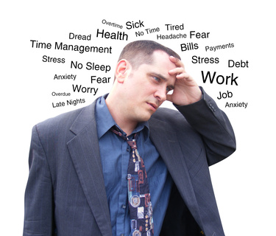
How does this make you feel?

Slide 15
How does this make you feel?

Slide 16
Key Insight: I can ENLARGE the channel of emotion and thus the flow of the Spirit by gazing longer and more steadfastly at the pictures God gives!

Slide 17
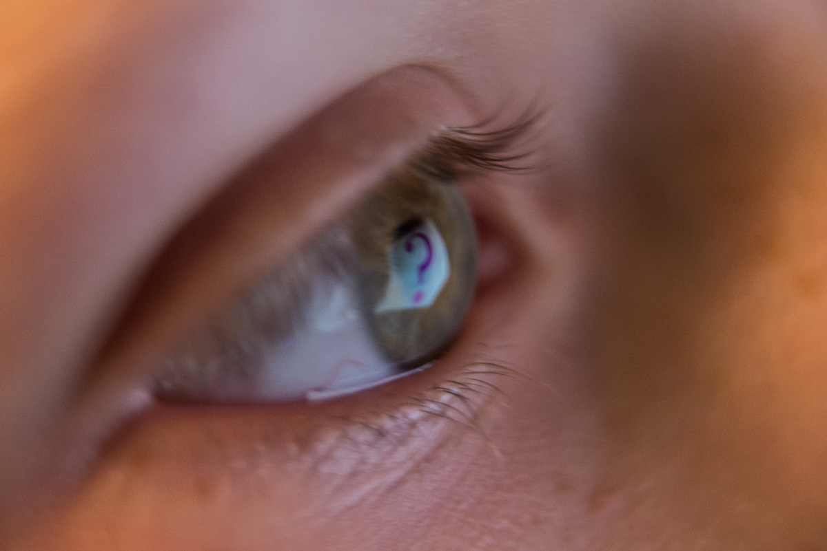
Key Insight!
Whatever I gaze upon grows within me and whatever grows within me, I become.

Slide 18
A key devotional emerged
River of Life cwgministries.org/immersed
Try it and experience a strong emotional and spiritual response.

Slide 19
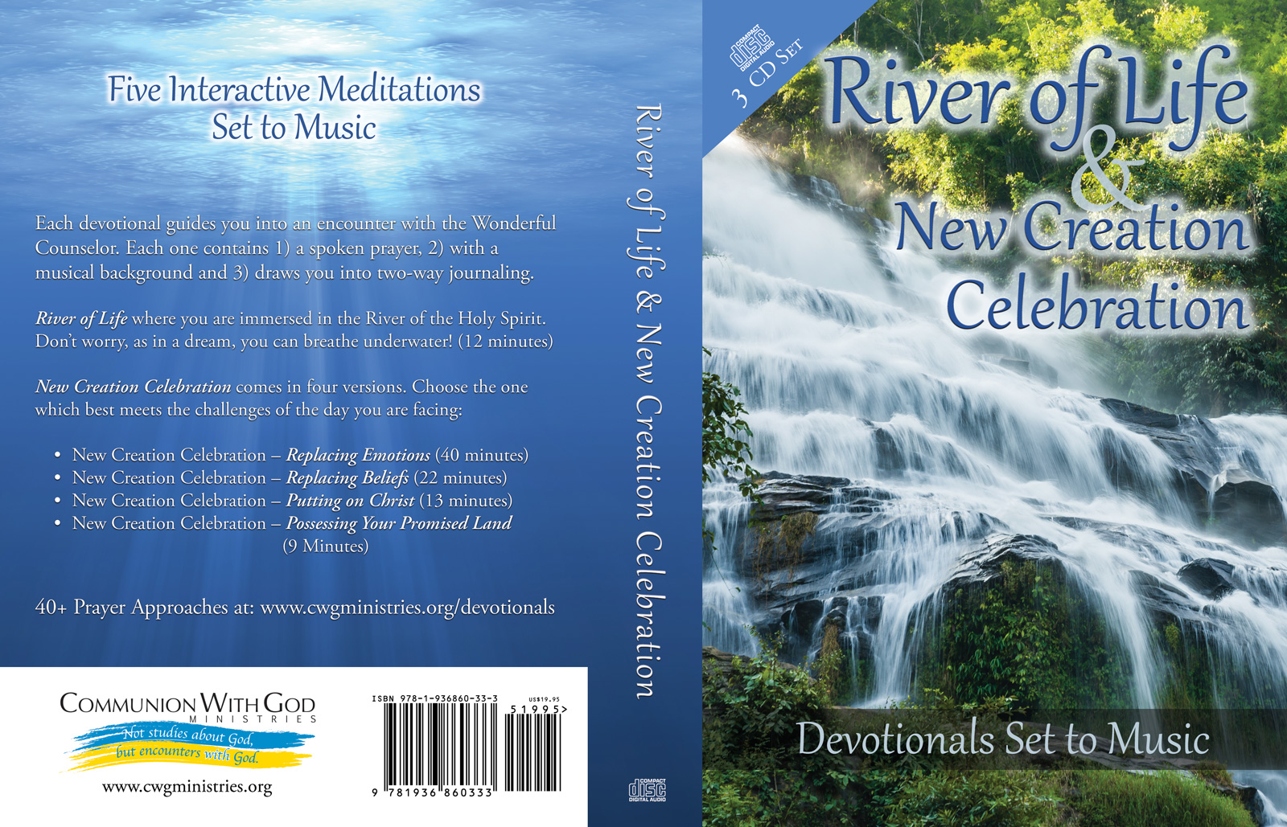

Slide 20
Chapter Two
Where do emotions come from?

Slide 21
Key Insight!
Emotions are produced by the pictures I gaze upon

Slide 22
Ideas, pictured, produce emotions.
I MUST know what I am looking at, always!

Slide 23
Any valid picture must include Jesus in it.
Heb. 12:1-2
Acts 2:25; Ps. 16:8

Slide 24
The pictures I gaze upon may be leftover lies about my “old self” or revelation truths concerning my “new self” in Christ.

Slide 25
In stepping from my old self to my new self, I am shedding any thoughts, pictures and emotions I still have which were part of my former darkened lifestyle, and I am putting on Christ’s thoughts, pictures and emotions.

Slide 26
Three possible origins of thoughts/pictures
Analytical thoughts/pictures - are connected, and constructed with my brain, thus coming from self, which is quickly filled with satan.

Slide 27
For example: reasoning outside God’s sanctuary, or when not in the presence of the Holy Spirit results in pictures containing lies and despair (Ps. 73:1-17).
Reasoning with God (Isa. 1:18) Reasoning in the Lord’s presence results in perception. (Ps. 73:18-20).

Slide 28
Flowing thoughts & pictures (Jn. 7:37-39)
Come from TWO primary spiritual sources

Slide 29
Satan, whose flowing thoughts & pictures are congruent with his nature
Accuser of the Brethren (Rev. 12:10, 11)
Father of Lies (Jn. 8:44)
Adversary and Enemy (Matt. 13:39)
Thief who comes to steal and kill and destroy faith, hope and love (Jn. 10:10).

Slide 30
Satan is the accuser (Rev. 12:10)
Consider the demonization of all who disagree politically, religiously, intellectually, medically
God’s response - Honor all people
(1 Pet. 2:17)

Slide 31
The Holy Spirit’s flowing thoughts and pictures are congruent with His nature
The Comforter (Jn. 14:16)
The Spirit of Truth (Jn. 16:13)
Convicts - no condemning (Jn. 16:8; 2 Cor. 7:3) Edifies and comforts (1 Cor. 14:3),
Loving (1 Cor. 13), gentle (Gal. 6:1), patient (1 Thess. 5:14) and filled with mercy (2 Cor. 1:3b)

Slide 32
Satan’s thoughts/pictures
I can’t
I lack
I fear

Slide 33
Satan’s thoughts/pictures produce emotional dis-ease
Anger, insecurity, worry, anxiety and more…

Slide 34
Satan’s thoughts/pictures produce physical illnessness
Digestive problems, insomnia and illness

Slide 35
God’s thoughts/pictures
I can do all things (Phil. 4:13)
Supply all your needs (Phil. 4:19)
I am with you always (2 Tim. 1:7)
Notes:
Php 4:19 And my God will supply all your needs according to His riches in glory in Christ Jesus.

Slide 36
God’s thoughts/pictures produce emotional health
Gratitude, love, joy, peace, thanksgiving and more…

Slide 37
God’s thoughts/pictures produce physical health
Good digestion, restful sleep, overall health

Slide 38
I used to spend 80% of my time living in demonic thoughts, pictures and emotions. Now I spend about 98+ percent of my time living in divine thoughts, pictures and emotions ( Faith, Hope, Love - 1 Cor. 13:13)
We take every thought captive to the obedience of Christ (2 Cor. 10:5).

Slide 39
The Power of the Cross
I step into my New Self
By believing, seeing and feeling what Christ has done for me. This is “TRUE Knowledge” (Col. 2:2)

Slide 40
“For by one offering [sacrifice] He [Jesus] has perfected forever those who are being sanctified.” (Hebrews 10:14 NKJV)
Believing, seeing and feeling the perfection as already complete is the way we step into our perfection.

Slide 41
12 things Christ provided at Calvary which we are to believe, see, feel, speak and experience. Pictures below are in red

Slide 42
I now have the Holy Spirit:
We receive the promise of the Spirit through faith (Gal. 3:13-14). A ball of light in my gut!

Slide 43
2. I now commune with God: They may be one, just as We are one (Jn. 17:22).
I take daily strolls with Him in His garden, His earth!

Slide 44
3. I now have new insides: A new heart and a new spirit I give you (Ezek. 36:26).
My heart is soft, healed, pulsating with life!

Slide 45
4. I now have power over sin
We die to sin and live to righteousness (1 Pet. 2:24).
The harness of sin is thrown off! I’M FREE!

Slide 46
5. I now have God’s glory The glory which You have given Me I have given to them (Jn. 17:22).
I glow with God’s glory

Slide 47
6. I now am righteous
We might become the righteousness of God in Him (2 Cor. 5:21)
I put on a robe of white, which is His righteousness!

Slide 48
7. I now am healed physically
By His wounds you were healed (1 Pet. 2:24).
My body is vibrant, healthy.

Slide 49
8. I now am financially prosperous
You through His poverty might become rich (2 Cor. 8:9)
I have more than enough which I share freely!

Slide 50
9. I now have hope
Christ in you, the hope of glory (Col. 1:27).
The OVERCOMER living within wins every time!

Slide 51
10. I now have peace
The peace of God, will guard your hearts and minds through Christ Jesus (Phil. 4:6,7)
I am floating on a beach, with no cares or worries.

Slide 52
11. I now am part of the family of God
Adoption as sons through Jesus Christ (Eph. 1:5) I’m part of a nurturing family.

Slide 53
12. I now have eternal life The gift of God is eternal life through Jesus Christ our Lord (Rom. 6:23).
I’m heaven bound!!!

Slide 54
The Cross has made ME flawless!
I have the Holy Spirit
I commune with God
I have a new heart and a new spirit
I have power over sin
I shine with God’s glory
I wear Christ’s garment of righteousness

Slide 55
The Cross has made ME flawless!
I am healed physically
I am financially prosperous
My mind is filled with hope
My heart is filled with peace
I am part of the family of God
I have eternal life

Slide 56
New Creation Celebration - Replacing Beliefs (22 minutes)
www.cwgministries.org/beliefs
Do it daily this coming week. Soak in Kingdom reality until you see ONLY the Kingdom.

Slide 58
Session 3
How do I step from my Old Self to my New Self?

Slide 59
Is my New Creation in Christ automatic, or is this something I work on becoming, or is it both?

Slide 60
It is past tense!
Therefore if anyone is in Christ, he is a new creature; the old things passed away; behold, new things have come. (2 Cor 5:17 NASB)

Slide 61
It is an ongoing process
Put on the new self who is being renewed to a true knowledge (Col. 3:10 NASB)
(i.e. a knowledge from the Spirit)

Slide 62
Why make it a process? "I will not drive them out (i.e. their enemies) before you in a single year, that the land may not become desolate and the beasts of the field become too numerous for you. I will drive them out before you little by little, until you become fruitful and take possession of the land (Ex. 23:29-30).

Slide 63
So I need to “Work out my salvation” (Phil. 2:12)
How? Does it involve grunting, straining?

Slide 64
No grunting or striving! We are transformed while we look (2 Cor. 4:16-18)
We behold as in a mirror the glory of the Lord, are being transformed into the same image from glory to glory (2 Cor. 3:17,18)

Slide 65
Where exactly do we look? Fixing our eyes on Jesus, the author and perfecter of faith
(Heb. 12:1,2)
I look to see what Jesus is doing and then I do what I see.

Slide 66
Looking at the wrong thing = death The Israelites in the wilderness looked at the adversities they were facing, rather than God’s promise in Ex. 12:25
“I have given you the Promised Land.”
They pictured, believed and spoke, they were going to die, and that is exactly what they received.

Slide 67
I have gazed in many wrong directions:
My sinfulness, and weakness and despair and sadness filled me.
Biblical laws, and legalism grew within me.
My successes, and pride and judgment grew within me.
The anti-christ, and fear grew within me.
Evil in the world today, and despair grew within me.

Slide 68
Life-changing Rhema from God
“Whatever you fix your eyes on grows within you, and whatever grows within you, you become.”

Slide 69
Gazing upon God’s promises, seen as already fulfilled, produces faith, creating transformation and attracting miracles.

Slide 70
Abraham gazed upon millions of stars, (God’s promise of children, fulfilled), and faith arose for a miracle (Gen. 15:5,6).

Slide 71
To gain the power of the Holy Spirit I MUST throw away reliance upon self.
If by the Spirit you are putting to death the deeds of the body you will live (Rom. 8:13).

Slide 72
The rich young ruler lost out by trusting in his money.
Blind Bartimaeus got his miracle by throwing down his cloak and leaping to his feet.

Slide 73
I must let go of my past to embrace God’s planned future!
I do not cling to past sins, inferiorities, self-consciousness, or inabilities. I give them all to Jesus. By trusting Jesus only I receive the power of His Spirit.

Slide 74
Steps to experiencing Spirit-born transformation
I ask for God’s help
I tune to flow and receive revelation
I cease my own laboring
I believe what the Spirit is giving
I ponder ONLY the promise fulfilled
I picture ONLY the promise fulfilled
I praise passionately thanking Him that “The promise is fulfilled”
I experience energy of the Spirit flowing within
I do what the Spirit within is directing

Slide 75
New Celebration Devotional
Replacing Beliefs
www.cwgministries.org/beliefs
As you complete this, you will be gazing upon your New Self in Christ, and His promises fulfilled.

Slide 77
Chapter 4
Cultivating Kingdom emotions and heightened Kingdom emotions

Slide 78
Perfect Peace When Your Imagination Is…what?
"The steadfast of mind (“Yêtser” = imagination) You will keep in perfect peace, Because he trusts in You (Isa. 26:3).

Slide 79
Of the nine times yêtser appears in the Bible, it is translated seven times as imagination which frames up your reality. See… cwgministries.org/imagination

Slide 80
New Creation Celebration Devotionals These incorporate pictures & emotions
Replacing Emotions (40 minutes)
Replacing Beliefs (22 minutes)
Putting on Christ (13 minutes)
Possessing Your Promised Land (9 min)
cwgministries.org/transformations

Slide 81
UNIQUE features of these devotionals
We begin by getting “in Spirit”
We listen for God’s voice and see His visions
We process one emotion/session
We throw off self-reliance

Slide 82
Unique features of these devotionals
We surrender to the power of Spirit
We “put on Christ” by gazing
We practice “walking by the Spirit”
We experience kingdom emotions
We ask for a confirming sign
Try it… you will like it!

Slide 84
Now, how about a theology for heightened Kingdom emotions
Jesus “felt compassion … and healed their sick” (Matt. 14:14).

Slide 85
“Revivals are intensely emotional and Christological in focus.”
Quote from a college research paper on “Revivals” by Mark Virkler

Slide 86
Any intense experience, if maintained for more than half an hour, can leave permanent changes in the neural circuits involving emotion and memory (Born to Believe by Andrew NewBerg, MD - Page 183).

Slide 87
Emotion is the energy that activates and releases the spirit (Charity Kayembe)
“Emotions are the channel of the spirit” (Mark Virkler)

Slide 88
Roaring at your enemy is an example of heightened kingdom emotions

Slide 89
Like as the lion and the young lion roaring on his prey...
Isaiah 31:4 King James Bible

Slide 90
So shall the LORD of hosts come down to fight for mount Zion, he will deliver it; he will preserve it (Isa. 31:4,5).

Slide 91
The kingdom of heaven suffers violence, and violent men take it by force (Matt. 11:12).
Roaring at Lyme’s disease

Slide 92
An example of Heightened Emotions
Bartimaeus who cried out and would not be silenced.
(Mk. 10:46-52)

Slide 93
Another Example of Heightened Emotion
And a Canaanite woman from that region came out and began to cry out (Matt. 15:22)

Slide 94
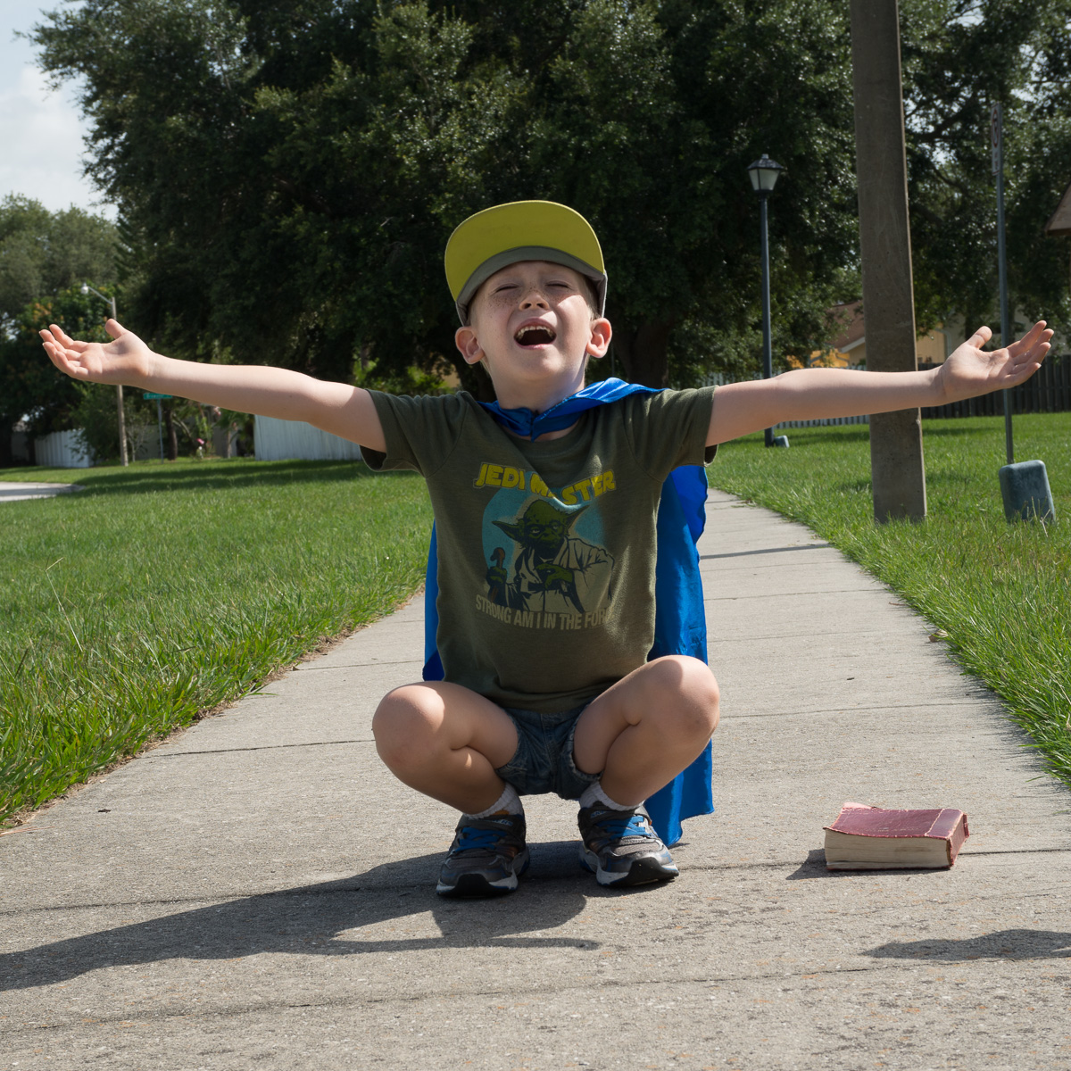
Crying out three times/day
Evening and morning and at noon I will pray, and cry aloud, and He shall hear my voice (Ps. 55:17).

Slide 95
“Will not God bring about justice for His elect who cry to Him day and night, and will He delay long over them? I tell you that He will bring about justice for them quickly.” (Lk. 18:7,8).

Slide 96
Prophetic gestures release spiritual energy, and when done in faith and passion, release MORE spiritual energy.

Slide 97
“You must strike the Syrians till you have destroyed them." Then he said, "Take the arrows"; so he took them. And he said to the king of Israel, "Strike the ground"; so he struck three times, and stopped.

Slide 98
And the man of God was angry with him, and said, "You should have struck five or six times; then you would have struck Syria till you had destroyed it! But now you will strike Syria only three times." (2 Kgs. 13:18-19 NKJV).

Slide 99
What we can learn…
Prophetic gestures release spiritual power
When done in faith and with passion, they release more power
When done half-heartedly they release less power.

Slide 100
Kingdom emotions compared to heightened kingdom emotions
Prayer vs. crying out
Meditation vs. roaring
Peace vs. joy unspeakable
Agreeing with a prophecy vs. acting out a prophecy
Worship vs. wholehearted praise

Slide 101
Use heightened kingdom emotions when you need a breakthrough, and normal kingdom emotions have not achieved the transforming miracle you are seeking.

Slide 102
A transforming miracle takes place the moment the energy of the Holy Spirit is experienced with enough force to override and replace the energy which has maintained the hardwired responses of my old self and any accompanying demons.

Slide 103
A 14-minute workshop utilizing heightened Kingdom emotions
I get in the Spirit: Come into God's presence by passionately praising Him for His greatness. Worship Him in tongues and in English. (1 minute)
I ask: Lord, what enemy do You want to defeat today? (1 minute)

Slide 104
A 14-minute workshop utilizing heightened Kingdom emotions
I ask: Lord, what sins do You want me to repent of (mine or others), so this enemy has no legal rights to affect the situation? (2 minutes)
I repent and become clean: I repent of these sins and then look to see Jesus present, cleansing me and making me white as snow. (2 minutes)

Slide 105
I come into agreement with what I see Jesus doing: I use the name of Jesus and join with Jesus in roaring at and rebuking the enemy and commanding the demons to be gone in Jesus' name! (2 minutes)
I ask, "Lord, what prophetic action do You want me to take to defeat this adversary?" Does He want me to strike, sever, push back, walk, leap, etc.? Listen for His direction. (2 min)

Slide 106
I perform His prescribed prophetic action with passion, conviction, intensity and thoroughness, knowing that as I do it, His Spirit's power is being released. (2 minutes)
I close in triumphant praise, giving God glory, in English and in tongues, THANKING Him that He HAS performed the work. It is DONE! This may include holy laughter. (2 minute)

Slide 108
Chapter 5
Faith working through love (Gal 5:6)
Faith is agreeing with God’s intention to perform a miracle

Slide 109
Faith works – regardless if I am working it in forward gear or reverse.
According to your faith, be it unto you (Matt. 9:29)

Slide 110
Ex. of properly aligned faith
“I can do all things through Christ who strengthens me. I am complete in Christ. God has given me the power to create wealth.” (Phil. 4:13; Col. 1:28; Deut. 28:1-14; 8:18).

Slide 111
Faith is one of 9 ways the spirit manifests (1 Cor. 12:9)
It is not something I work up. I ask and receive and believe His word & vision.

Slide 112
Activating faith involves writing God’s truth on the walls of our hearts.
This requires using the language of our hearts

Slide 113
David’s Psalms are heart statements
Heart statements: present tense statements which are personal, positive affirmations:
You, O LORD, are a shield about me (Ps. 3:3)
The LORD sustains me (Ps. 3:5)
You have smitten all my enemies (Ps. 3:7)
Not goals or ought to’s…

Slide 114
Faith is living truth, acted upon
Revealed by the Spirit (Jn. 7:37-39; Lk. 24:32,45)
Pondered and meditated upon until it is reality within (Ps. 19:14; 49:3; Prov. 4:20-23)
Embraced as my present tense reality (Ps. 3:3)
Positively affirmed (Mark 11:22-24)
Visually seen (Matt. 13:34; Eph. 1:18; Gen. 15:6; Eph. 1:17,18)
Emotionally felt (Matt. 14:14; Rom. 14:17; 15:13; Gal. 5:22).
Acted on (Ja. 1:26; 2:17; Matt. 9:6,7).

Slide 115
A steadfast imagination produces an emotional response of perfect peace, which in turn frames up and creates my reality (Isa. 26:3).

Slide 116
Example of writing truth on heart
Inner healing requires the use of the language of the heart. In inner healing, we invite Jesus to show us where He is in the trauma and what He is saying and doing.
We tune to flow and receive.

Slide 117
Embracing this new picture, which contains Jesus alive and ministering God’s response, heals our hearts. We have used the language of the heart.

Slide 118
Gazing steadfastly upon God’s pictures inflames faith and emotions
When praying for healing for a person, I may look at Jesus’ scourged body, a powerful picture of the extraordinary price Jesus paid to purchase healing.
This results in inflamed faith and I am emotionally passionate to release His precious compassionate gift.

Slide 119
Examples of faith enlarging pictures
Living in the state of vibrant health means I get to:
Fulfill my God-given destiny
Celebrate my grandchildren
Live on a cruise ship rather than in a nursing home
Skip doctors’ offices, hospitals, meds, operations and degenerative diseases

Slide 120
God’s Laws remain as a safety net providing another set of pictures of the consequences of breaking God’s Laws.

Slide 121
My primary focus remains on the positive results of living in faith, rather than on the consequences of living in sin.

Slide 122
Abraham, the Father of Faith, models the ingredients of heart faith

Slide 123
1. I hear God’s voice. God speaks a promise and faith is ignited in my heart. Abrams’ faith walk began when God spoke to him (Gen. 12:1-3).

Slide 124
2. I see God’s vision of the promise fulfilled. God shows Abram millions of stars which is a picture of Abram’s millions of descendants (Gen. 15:5).

Slide 125
3. I ponder God’s rhema and vision in my heart (Rom. 4:20-21). I do not spend part of my day reverting back to gloom, fear, lack or pessimism. I am not double-minded (Ja. 1:6-8).

Slide 126
4. I speak God’s promise as my personal, positive, present tense reality. In Gen. 17:5 Abram’s name is changed from Abram to Abraham, meaning “father of a multitude.” His confession becomes, “I am Abraham,” or to be crystal clear:
“I am the father of a multitude.”

Slide 127
Derek Prince defines a right confession as… “Saying only what God says about our situation and keep on saying it.”

Slide 128
We don’t want to allow a thought in our minds about ourselves that God doesn’t have in His mind about us.
God is Good by Bill Johnson – Ch. 2

Slide 129
5. I act. Emotions move me to action. In Gen. 17:10,23, God speaks and Abraham acts by obeying that very same hour.

Slide 130
6. I avoid injecting my ideas
No Ishmaels – man’s ideas
“My thoughts are not your thoughts” (Isa. 55:8)

Slide 131
7. In the fullness of time, God brings forth a miracle (Gal. 4:4). Some miracles are instantaneous, while many are progressive. (Abraham’s: 25/1500 years)

Slide 132
Identifying your Promised Land (your destiny)
God has a destiny for you. Ask Him, “What is Your destiny for my life?”

Slide 133
Double-mindedness kills
Let not that man suppose that he will receive anything from the Lord; he is a double-minded man. (Ja. 1:5-8)

Slide 134
See ONLY ONE Reality
"The eye is the lamp of the body; so then if your eye is clear, your whole body will be full of light” (Matt. 6:22).

Slide 135
There is no reason for me to look away from God’s promises and see satan’s darkness.
Jesus sure didn’t…

Slide 136
Will a split vision work?
In devotional times I see and believe one thing, & the remainder of the day see, believe and feel another thing.

Slide 137
God’s miracles occur when I get beyond the state of duality. When…
I continuously see, believe, feel and speak only one reality.

Slide 138
The day that the joy of the end result becomes mine, because I have my eyes fixed continuously on the prize, on that day I have the title deed to my new reality.

Slide 139
God spoke to me “Whatever you fix your eyes upon, grows within you; whatever grows within you, you become.”

Slide 140
Since I become what I gaze upon, I want to gaze upon my new creation self, who I am in Christ.

Slide 141
Goals miss the mark
Rather than having goals, we have states. So I would not want to say, for example, “My goal is vibrant health.” Instead, I say, “I live in the state of vibrant health” (Isa. 53:5).

Slide 142
Journaling: Lord, what do you want to speak to me concerning being single-minded about my destiny and my health? Am I double-minded? How would You have me deal with this?

Slide 143
Chapter 6
“Faith working through (energized by) love” (Gal. 5:6)
Exploring the energizing power of the Holy Spirit

Slide 144
Greek word is energeo which literally means “energized by.” This energizing power of the Holy Spirit fills everything, everywhere. In Him all things hold together (Col 1:17).

Slide 145
Do not grieve the Holy Spirit of God (Eph. 4:30)
Let’s discover how we grieve or magnify the Holy Spirit.

Slide 146
We magnify the Holy Spirit by
Honoring and welcoming His presence and power
Looking and seeing Him
Listening to Him

Slide 147
It is the Spirit who gives life; the flesh profits nothing; (Jn. 6:63,64) Apart from Me you can do nothing (Jn. 5:5).

Slide 148
Cursed is the man who makes flesh his strength, (Jer. 17:5).
For the mind set on the flesh is death, but the mind set on the Spirit is life and peace (Rom. 8:6)

Slide 149
You are NOT in the flesh but in the Spirit (Rom. 8:9).
My confession is that…
I honor You, Holy Spirit. I trust completely in YOU!

Slide 150
In-depth definition of Energeo
Kittle – Theological Dictionary of the New Testament: Active energy, to be at work

Slide 151
In-depth definition of Energeo
Robinson’s Word Pictures: To energize, God is the energizer of the universe

Slide 152
A Working Definition of Energeo: Energeo is the power of God available through the Holy Spirit which accomplishes God’s work. We experience it as flowing, active energy. Have you felt it?

Slide 153
What does Energeo do?
Energeo energizes hearts
For it is God who is at work (energeo - energizes) in you, (Phil. 2:13 NASB).

Slide 154
Energeo makes verses leap
For the word of God is living and active (energeo -energizing), and sharper than any two-edged sword (Heb. 4:12 NASB).

Slide 155
Energeo opens doors
A wide door for effective (energizing) service has opened to me (1Cor. 16:9 NASB).

Slide 156
Energeo produces miracles
So then, does He who provides you with the Spirit and works (energizes) miracles among you, do it by the works of the Law, or by hearing with faith (Gal. 3:5 NASB)?

Slide 157
I want to experience energeo!
So let’s explore what energeo feels like

Slide 158
Hands energized by the Holy Spirit, is sensed as warmth, fire, heat, tingling and energy. (Lk. 5:17; Mk. 5:30).

Slide 159
Heart energized by the Holy Spirit is sensed as an inner quickening resulting in a flow of faith, hope, love, compassion, joy, peace, mercy, power or our hearts burning within. (Gal. 5:22; 1 Cor. 12:7-11; Lk. 24:32).

Slide 160
Lips energized by the Holy Spirit is sensed as a flow of words which come through the instruction of the Holy Spirit (1 Cor. 2:13) and sets the captive free (Lk. 4:32). We are “speaking the oracles of God” (1 Pet. 4:10,11).

Slide 161
Energeo flowing from our hearts…
adds persuasiveness to our lips (Prov. 16:23)
The Holy Spirit teaches our lips what to say (1 Cor. 2:13).

Slide 162
Work energized by the Holy Spirit is sensed as working at ease, experiencing flow, creativity and productivity and is considered a “live work” rather than a “dead work” (Heb. 6:1,2).

Slide 163
Mind energized by the Holy Spirit is sensed as flowing, creative thoughts and is called “the mind of Christ” (1 Cor. 2:1-16).

Slide 164
We increase the Spirit’s flow by…
Inviting His presence (Eph. 4:30)
Worshipping in Spirit (Jn. 4:23,24)
Hearing and seeing what Jesus is doing and doing the same thing (Jn.5:19,20,30)

Slide 165
Rather than seeing empty space…
I choose to see true reality, to see God’s energy, flowing everywhere, all the time. I see God’s Spirit, energizing every atom, transforming every molecule and healing all who are oppressed by the devil.
“In Him all things hold together”

Slide 166
I see shimmering waves of light around me. When I look to the throne room I also see Him as shimmering waves of light and energy, swirling around the thrones of God and Jesus. I see His energy lighting me within.

Slide 167
Journaling meditation exercise Lord, what do you want to speak to me concerning seeing and trusting in the presence and the power of your Spirit in and through me?

Slide 168
Application exercise - do the River of Life Devotional
cwgministries.org/immersed
Saturate yourself and soak in the Holy Spirit daily

Slide 170
Chapter 7
“Faith energized by love” (Gal. 5:6)
Love is God’s on/off switch for unleashing healing power

Slide 171
LOVE and FEAR are KEY emotions contrasted in Scripture. Both move us.
Perfect Love casts out fear
(1 Jn. 4:18)

Slide 172
God’s thoughts (truth),
when aligned with God’s emotion of love, release God’s power (Gal. 5:6)

Slide 173
God’s thoughts (truth), when aligned with satan’s emotion of fear, release no result
Mis-matched alignment

Slide 174
Satan’s thoughts (lies), aligned with satan’s emotion of fear, release satan’s power. What I fear comes upon me (Job. 3:25)

Slide 175
Align the following three
Heart - emotions
Head - beliefs
Body – speech
And the Spirit’s power is released

Slide 176
Jesus “felt compassion for them and healed their sick.” (Matt. 14:14)
He felt, He believed, He spoke

Slide 177
Compassion is the divine frequency upon which God’s power is carried and released. For Jesus, emotions were the channel of the Spirit’s power.

Slide 178
Spurgeon: The word compassion is a very remarkable one. It is not found in classic Greek. It is not found in the Septuagint. The fact is, it was a word coined by the evangelists [Gospel writers] themselves. They did not find one in the whole Greek language that suited their purpose, and therefore they had to make one.

Slide 179
Compassion was a noun up until the time of the Gospel writers, and they changed it into a verb to describe the intensity of Jesus’ heart of compassion toward the people. Spurgeon was right!

Slide 180
Compassion - splank na Strong’s Hebrew and Greek Dictionary:
“To have the bowels yearn”

Slide 181
A practical definition of “compassion”
God’s yearning heart of mercy and love, releasing healing and provision to those in need.

Slide 182
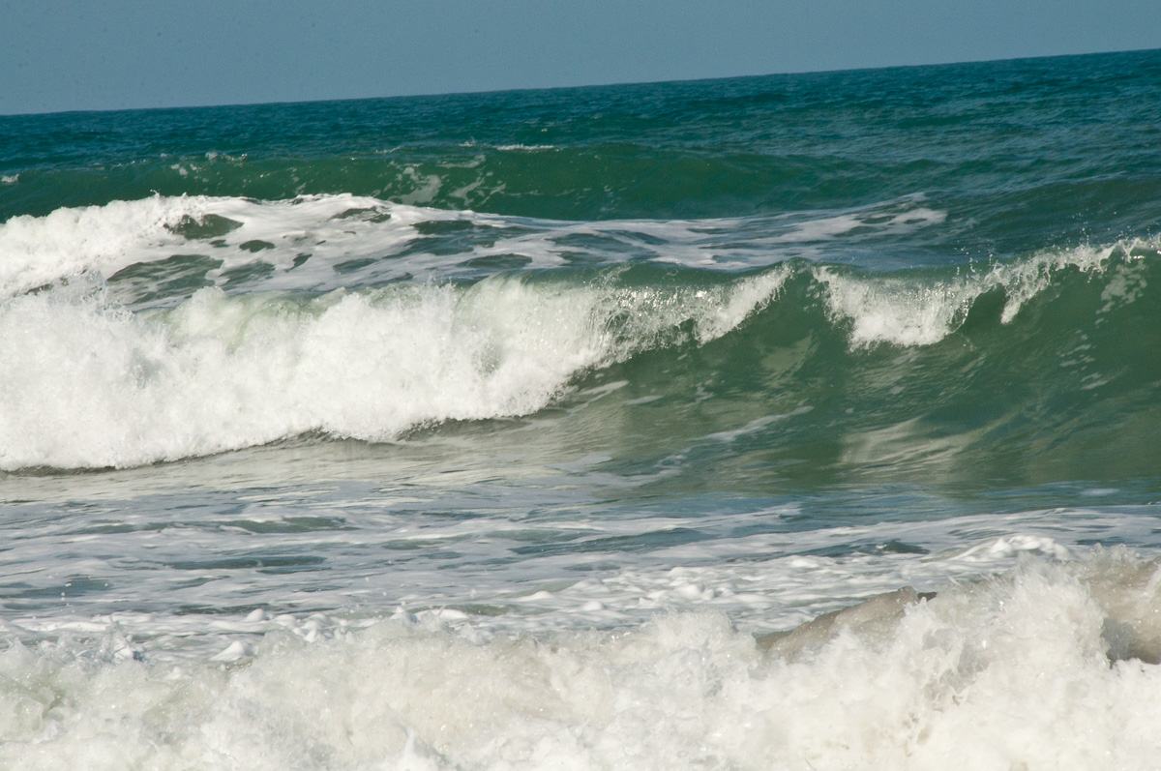
Compassion is
“A wave in God’s ocean of love which moves us to act.”

Slide 183
The Gospels declare compassion accomplished all the following:
Preaching, healing, food multiplication, debts forgiven, deliverance and caring for the physical needs of those in distress.
Do everything from compassion!

Slide 184
All ministries originate from the emotion of love, initiated by God Himself. Never, from guilt, obligation, fear or legalism!

Slide 185
Rather than strive with my flesh’s strength, I tune to and align with the Spirit’s compassion, purpose, power and direction.

Slide 186
God’s healing power rides on the wings of
Faith, birthed in rhema and vision, coupled with God’s compassion,
which I speak as my
personal, present-tense, reality.

Slide 187
Join heart and mind
In everything give thanks (1 Thess. 5:18)
God’s beliefs for good in my mind (plus)
God’s emotion of gratitude in my heart Releases Holy Spirit power

Slide 188
JOIN heart and mind
In everything give thanks (1 Thess. 5:18)
MIND - Believes God is Good
HEART - Feels gratitude
Holy Spirit power is released

Slide 189
Gratitude is the frequency of receivership
“We fully expect great things, but we surrender the when and how.”

Slide 190
Here are experiences where we normally have faith energized by love
A revivalist miracle service
On missions trips
During heartfelt intercession
Receiving baptism or communion while intending to receive a miracle

Slide 191
Is it OK to ask for a sign while I wait? YES!
David asked - Show me a sign for good… (Ps. 86:17).
Gideon asked for a sign (Judges 6)

Slide 192
Kingdom Emotions Application
Complete the “New Creation Celebration -Replacing Emotions” (40 minutes)
cwgministries.org/emotions
Do it daily until emotionally transformed

Slide 194
Experience the 7 Step Healing Model
Love – Express Compassion toward Self and Others
Honor – Ask, “What’s Wrong?”
Sensitivity – Become Still, Listen & Follow God’s Instructions – Forgive ALL That Come to Mind
Awareness – Invite God’s Compassion & Power to Heal
Authority – Command Body, Be Healed in Jesus’ Name
Thanksgiving – Thank God as I Test Out My Body
Faith – Repeat – Pray a Second, Third and Fourth Time

Slide 195
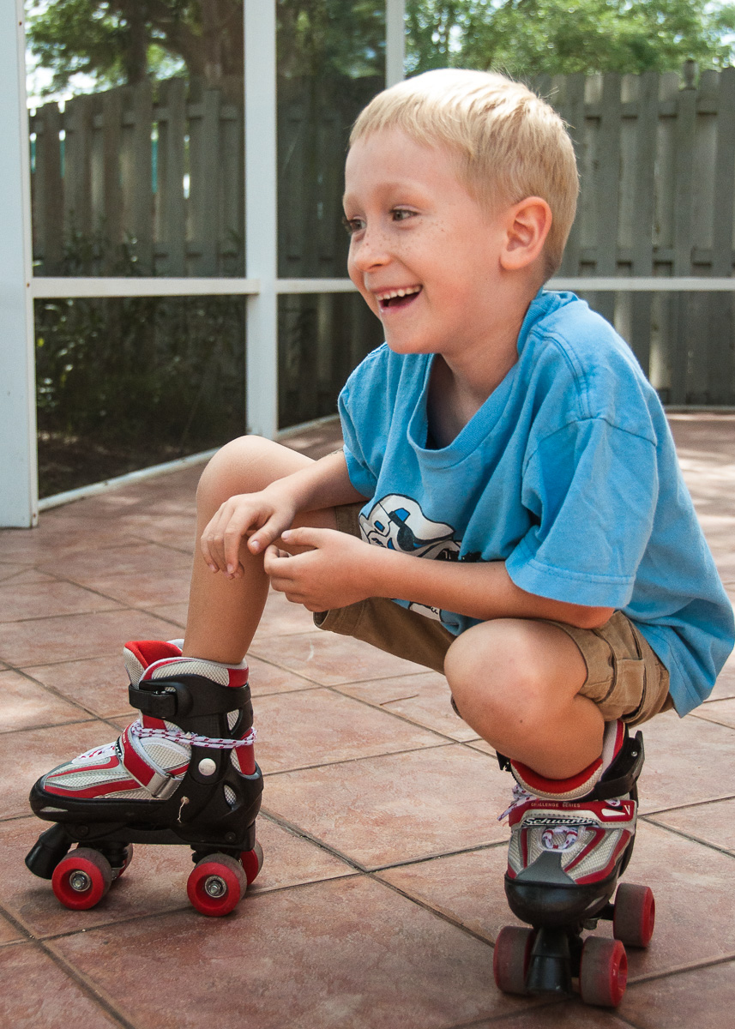
Chapter 8
Kingdom Emotions Turn on Healing Genes
A joyful heart is good medicine… (Prov. 17:22)

Slide 196
Kingdom Emotions are…
Love, joy, peace in the Holy Spirit (Rom. 14:17; Gal 5:22-25)
Thankfulness for and in all things (Eph. 5:20; 1 Thess. 5:18)
Gratitude (Heb. 12:28)

Slide 197
Fighting slows healing 40%
Therefore we speak only words edifying for the need of the moment (Eph. 4:29).

Slide 198
Those who perform altruistic acts live longer, reducing their odds of an early death by 60%.
By losing life we find it

Slide 199
Optimistic people have a 23% lower risk of death from cardiovascular disease and a 55% lower risk of death from all causes compared to their more pessimistic peers.

Slide 200
Those who live in the state of happiness tend to die of old age, with less than 1% of them dying of cancer or heart disease.

Slide 201
75% of people who die of heart disease and 15% of those who die of cancer are members of the Lifelong Anger Club

Slide 202
Ninety percent of our genes are influenced by their environment, which in turn is influenced by our thought processes.

Slide 203
The “Relaxation Response”
causes 1561 genes to change
874 upregulated (turned on) for health (immune function, etc.)
687 downregulated (turned off) for stress (inflammation, etc.)

Slide 204
Stress causes epigenetic change
Physical stress (bodily trauma)
Chemical & EMF (toxins/energy)
Emotional stress (fear, worry)
Stress sets off more than 1,400 chemical reactions and produces more than 30 hormones and neurotransmitters.

Slide 205
Picturing impacts muscles
In a French study those who imagined lifting heavier weights activated their muscles more than did those who imagined lifting lighter weights.

Slide 206
Picturing impacts skills Mentally practicing a simple, five-finger piano exercise for two hours a day for five days, made the same brain changes as subjects who physically practiced the same activities.

Slide 207
Abraham sees & faith grows
God showed Abram a picture of the promise fulfilled and faith arose in his heart (Gen. 15:5,6)

Slide 208
Alignment Releases Spirit Power (Eccl. 4:12)
The Mind-believes God’s promises (according to your faith, Matt. 9:29)
The Heart-feels God’s love which displaces fear (thinks in his heart, nephesh/emotion Prov. 23:7; 1, Jn. 4:18).
The Body-speaks life (life is in the power of the tongue, Prov. 18:21)

Slide 209
We have a brain in our hearts!
The heart sends more signals to the brain than the brain sends to the heart!
The brain continuously responds to the heart’s signals.
When the heart rhythm pattern is erratic and disordered, there is disharmony throughout one’s being.

Slide 210
Coherence Is a State of Optimal Function
The HeartMath Institute’s research has shown that generating sustained positive emotions
facilitates a body-wide shift which is a measurable state. They term this "coherence" because it is characterized by increased order and harmony in our minds, emotions and body, producing a state of optimal function.

Slide 211
The human brain takes in 11 million bits of information every second but is only consciously aware of 50. So my true self is the unconscious part of me, which the Bible calls the heart. Prov. 4:23 says that… Out of the heart flow the issues of life

Slide 212
Eyes more powerful than ears
Ten million bits of information per second come in through the eyes.
100,000 bits/sec. through the ears.
Pictures are the language of the heart and pictures are where things are at! “We are transformed while we look…”

Slide 213
Transformed by the pictures I ponder
10 million bits of information per second come in through the eyes
100,000 bits of information per second come in through the ears
I am consciously aware of 50 bits per second
Memorize: 2 Cor. 3:17,18;4:18; Matt. 13:34
Jesus taught using pictures

Slide 214
How fast can healing occur?
A red blood cell can make a complete circuit of your body in 20 seconds meaning that what I see, or picture can affect my health within minutes, if not seconds.

Slide 215
Not being grateful is NOT an option
"Because you did not serve the LORD your God with joy and a glad heart, for the abundance of all things; therefore you shall serve your enemies whom the LORD will send against you. (Deut. 28:47-48).

Slide 216
Whatever is true, whatever is honorable, whatever is right, whatever is pure, whatever is lovely, whatever is of good repute, if there is any excellence and if anything worthy of praise, dwell on these things … and the God of peace will be with you (Sustaining Presence - Phil. 4:8,9).

Slide 217
FEEL TODAY the emotions of God’s promise fulfilled, by seeing it already done!
As I behold a picture of God’s vision of my future reality, I am living in the future moment now. My emotions are excited with gratitude, and I am in the state where God’s miraculous grace releases His divine provisions.

Slide 218
End your prayers in the emotional state of thanksgiving
Be anxious for nothing, but in everything by prayer and supplication with thanksgiving let your requests be made known to God (Phil. 4:6).

Slide 219
Faith + heightened kingdom emotions
Together they release the Spirit’s power. Now you have: 1) opened up new receptors, and 2) signaled new genes in new ways, and 3) released the Holy Spirit.

Slide 220
Gazing transforms!
Picturing God’s promises already fulfilled, signals up the emotions of gratitude and thankfulness which flood our beings, causing a cascade of millions of healing responses in our bodies, plus supernatural grace flows.

Slide 221
Beliefs and emotions DO lodge in our cells and not just our minds
How long shall your evil thoughts lodge within you? (Jeremiah 4:14).
Anger rests in the bosom of fools. (Eccl. 7:9)
Hope purifies our beings (1 Jn. 3: 3).

Slide 222
Putting on Christ
If in our daily devotionals we continue to practice a new series of pictures, behaviors, and experiences, then our brain actually physically changes. It installs new neurological circuitry. Our body produces epigenetic changes which lead to structural and functional changes and God’s miracle working power flows.

Slide 223
In the New Creation Celebration Devotionals
You are experiencing a taste of this future experience, NOW! Your brain and body believe they’re actually living in your new creation in Christ in the present moment, and YOU ARE!

Slide 224
In the New Creation Celebration devotionals
You are putting on the New Self who is being renewed into a TRUE knowledge in Christ.

Slide 226
What do I do Next?
Review these principles until you are living them.
Explore the topics below

Slide 227
Clearing Cellular Memories
Chapter 9 of Unleashing Healing Power Through Spirit-Born Emotions & cwgministries.org/cellular

Slide 228
Remove evil spirits
Chapter 10 of Unleashing Healing Power Through Spirit-Born Emotions & cwgministries.org/7prayers

Slide 229
Develop Heart Coherence
Chapter 11 of Unleashing Healing Power Through Spirit-Born Emotions & cwgministries.org/GratefulHeart

Slide 230
40+ Ways To Pray
Chapter 12 of Unleashing Healing Power Through Spirit-Born Emotions & cwgministries.org/devotionals

